Slide 1
The insight toolkit image registration framework
Brian B. Avants
Nicholas J. Tustison
Michael Stauffer
Gang Song
Baohua Wu
James C. Gee

Slide 2


Definition from wiki
Image registration is the process of transforming different sets of data into one coordinate system. Data may be multiple photographs, data from different sensors, times, depths, or viewpoints…

Slide 3
Background
Insight Toolkit(ITK) is an open-source, cross-platform library that provides developers with an extensive suite of software tools for image analysis. Developed through extreme programming methodologies, ITK builds on a proven, spatially-oriented architecture for processing, segmentation, and registration of scientific images in two, three, or more dimensions.
The latest version is 5.1.2 (12/8 2020)
language：c++, python, javascript

Slide 4
Motivation
The software was selected randomly by me at first time. I finally decided to introduce the topic because it can use python language which is slightly familiar to me. uhhh... In fact, I haven’t used python since last semester and almost forgot how to do.
However, ITK doesn’t provide any visualization functionalities. If applications requires visualization, we need to install another software, such as 3D Slicer, The Visualization Toolkit (VTK),and etc. additionally. Accidently, I found an easy-to-start software based on ITK, SimpleITK, which supports image IO, basic image manipulation,ITKv4 registration framework, and so on.

Slide 5
Why do I use SimpleITK instead of ITK.
SimpleITK can easily visualize image using Jupyter notebook without installing additionally toolkit.
There are many tutorial videos about how to use python packages SimpleITK on the official YouTube’s channel named SimpleITK, furthermore, most of examples on official ITK website are programmed in C++.
I only want to demonstrate simple image registrations with light weight operations.

Slide 6
Purpose
Core software components
ITK transforms should be unified
Image registration should be achievable in one step
Registration mappings should be applicable to a number of popular data types, including DTI
Affine and deformable similarity metrics should look as similar as possible
Users should be able to combine multiple similarity metrics, some of which may operate on different data types
Optimizers and transformations should interact flexibly
GPU and multi-core acceleration will open up new applications for image registration
Improve memory efficiency in optimization framework

Slide 7
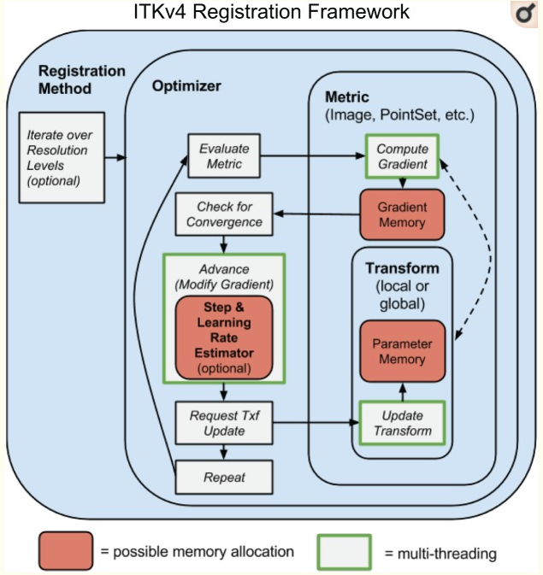
Core software components

Slide 8
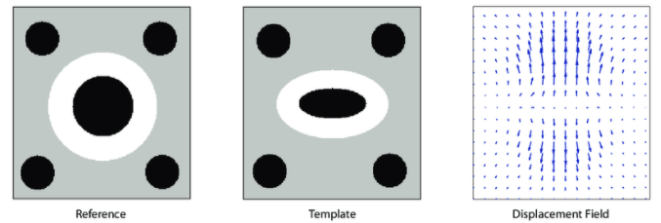
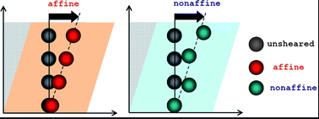
Local v.s. Global
Affine : it preserves parallelism, collinearity
deformation(變形)
Left figure:https://www.researchgate.net/figure/The-concept-of-displacement-fields-A-displacement-field-gives-for-every-pixel_fig1_267946997
Right figure:https://pubs.rsc.org/en/content/articlelanding/2012/sm/c2sm25364j#!divAbstract
Notes:
Each ITK⁴ transform now has either global support (affine transform) or local (or compact) support (a displacement field transform)

Slide 9

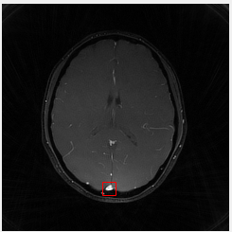
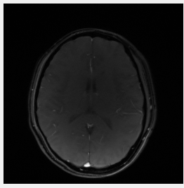
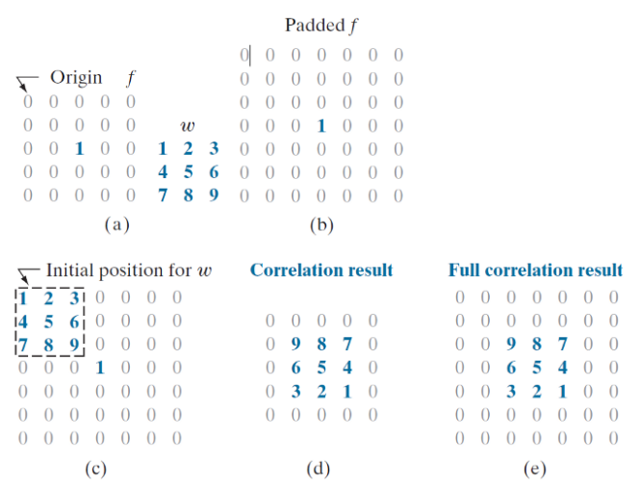
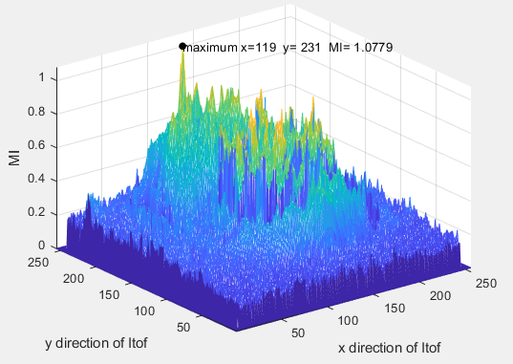
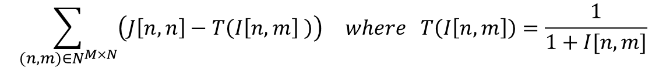
Similarity metrics
Mean squares Pattern intensity
Mutual information Normalized correlation
$$\sum_{(n,m)∈N^{M×N}}{\left(J\left[n,n\right]−T\left(I\left[n,m\right] \right)\right)} where T\left(I\left[n,m\right]\right)=\frac{1}{1+I[n,m]}$$
Reference:
https://datascience.stackexchange.com/questions/48642/how-to-measure-the-similarity-between-two-images
https://itk.org/Doxygen413/html/ImageSimilarityMetricsPage.html
Figure: h ttps://towardsdatascience.com/convolution-vs-correlation-af868b6b4fb5

